Slide 1
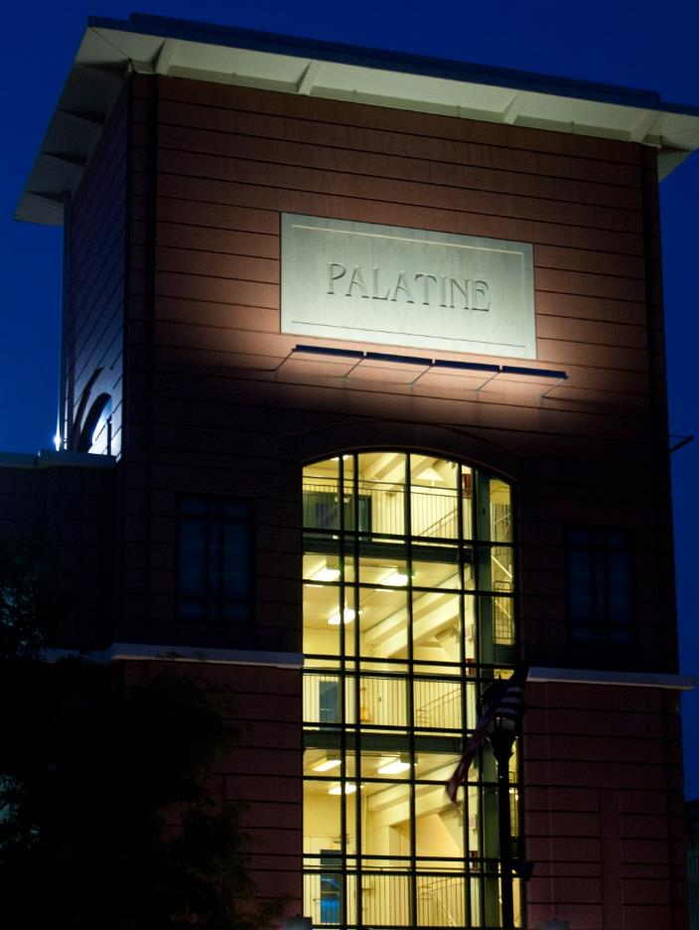
District Three
Advisory Meeting
July 28, 2022
Doug Myslinski
Councilman

Slide 2
Jim Schwantz
Mayor
Doug Myslinski
Village Council
Reid Ottesen
Village Manager
Matt Barry
PW Director
Mike Campbell
Sergeant
Chris Stearns
Patrol Officer
Hadley Skeffington-Vos
Deputy Village Manager

Slide 3

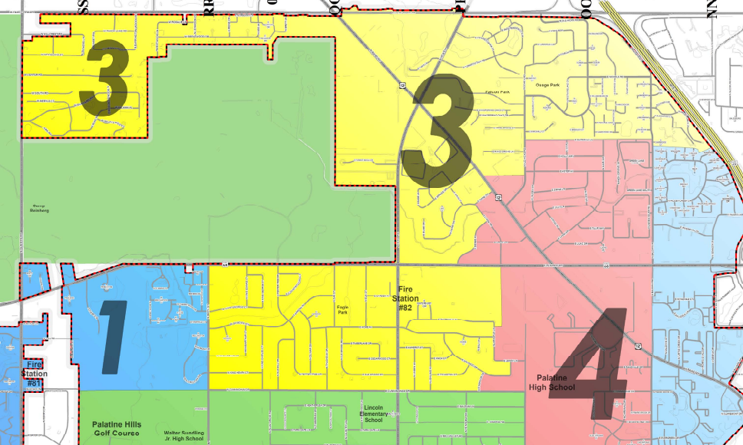
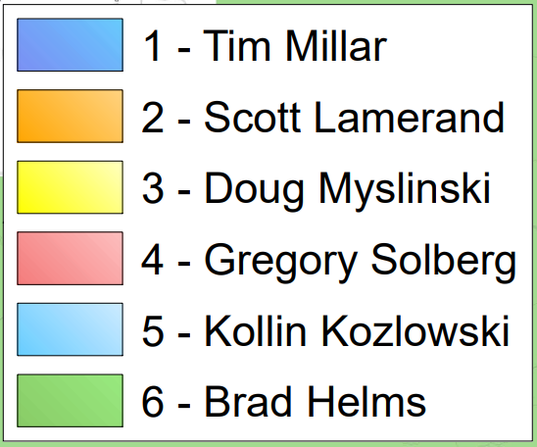
Village Council District Map

Slide 4

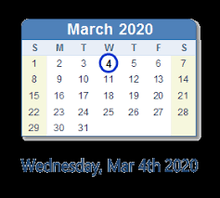
2020/21 – A Look Back
677 Days to Remember (or Forget)
March 4, 2020 at 1:34 p.m..

Slide 5
677 Days of Chaos and Opportunity
Managing Village Operations and Access to Customers
Cutting $5 million in middle of the year
Cuts included 2 police and 3 fire
Leader in Effort to Change the Phasing of Reopening
Maintained AA+ Bond Rating in 2020 while others dropped
10 community protests including crowds in excess of 200 people
Vaccination Clinic – record numbers
$5 million in grants over 2020/21
Police Beat Realignment
Mazda and Subaru Opening

Slide 6




2022
A Return to “Normal”

Slide 7
2022 Budget and Finances
$125,059,885 Budget
Restored 2 police officers and 3 firefighters
$1.9 million increase in capital (16% increase)
Reserves set-a-side to cover sales tax impact of car dealership decline
No Increase in Property Tax Levy

Slide 8

Local Taxing District’s Total Property Tax Levy Increase for 2006 - 2019
Total % Property Tax Levy Increase
52%
48%
34%
32%
27%
21%
20%

Slide 9
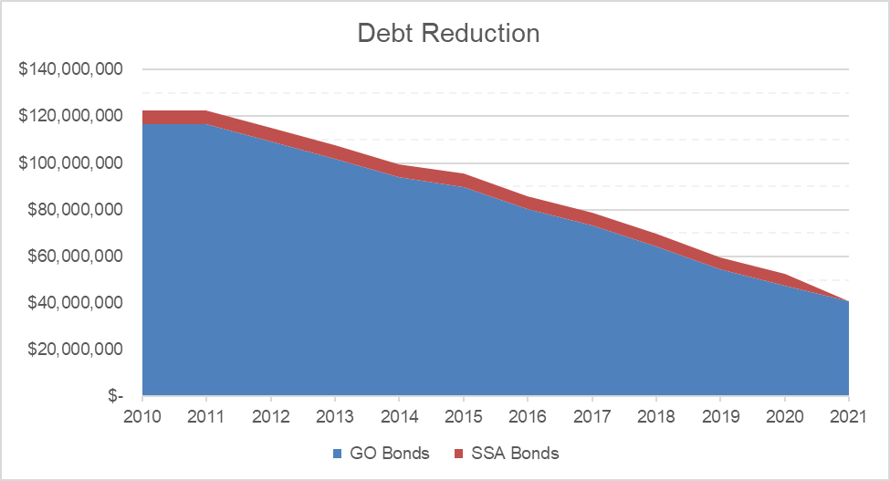
Outstanding General Obligation Bonds Last 10 Years

Slide 10
American Rescue Plan Act (ARPA)
Significant Focus on Infrastructure and Public Safety
Fire Station 82 - $3 million
Fire Truck - $1.35 million
Police Bodycam/Taser/Dashcam - $3.4 million
Creek Stabilization - $1 million
Lead Service Line Replacement - $390,000
LED Lighting Replacement - $500,000
Outdoor Warning Sirens - $300,000

Slide 11
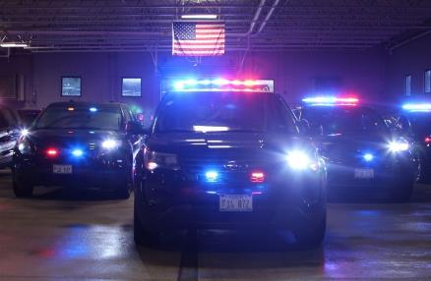
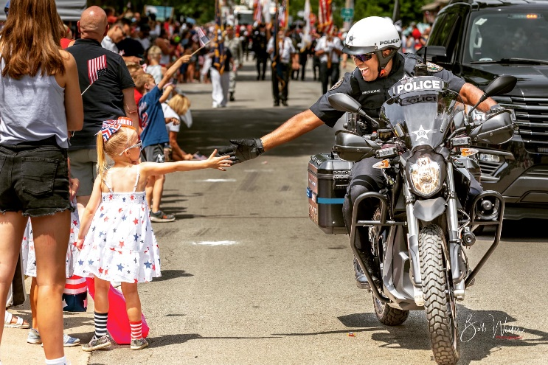
Initiatives
Maintaining Neighborhood Based Policing (NBP)
Walking Beats
Electric Motorcycle
Body Cameras
Recruitment Initiatives
Police Initiatives and Issues
Sergeant Campbell
Officer Stearns
Officer Ghalib
Police Activity
Increased domestics
Catalytic Converters
Scams on Seniors
Vehicle Theft & Burglaries

Slide 12







Development Update

Slide 13
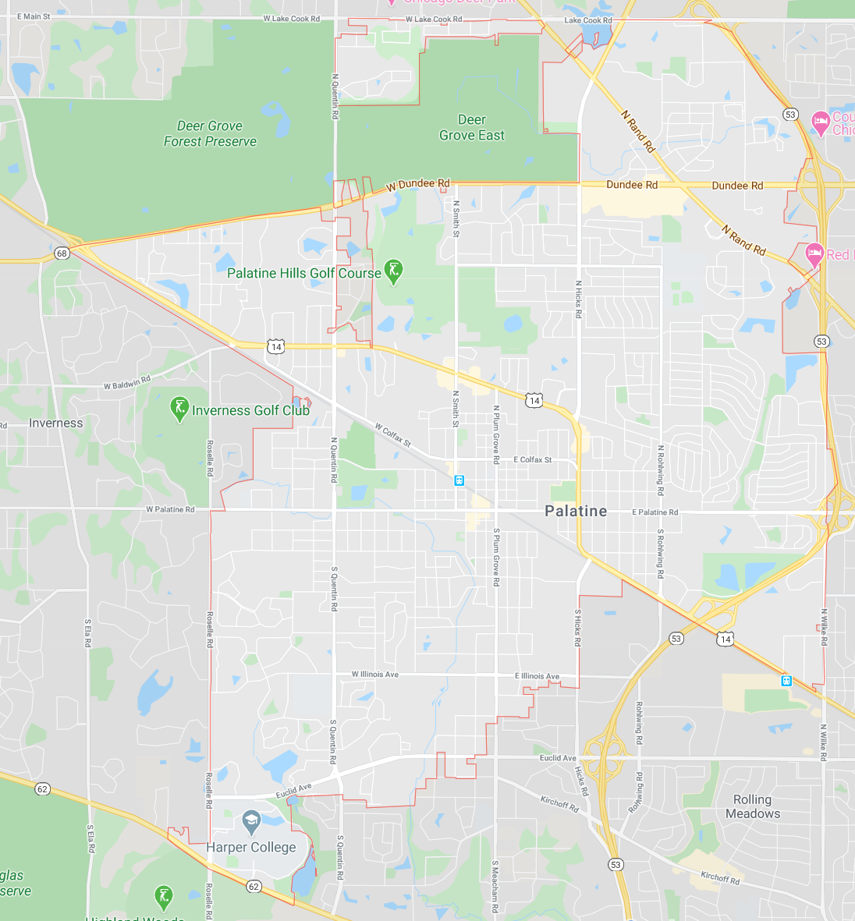
Development Update

Slide 14
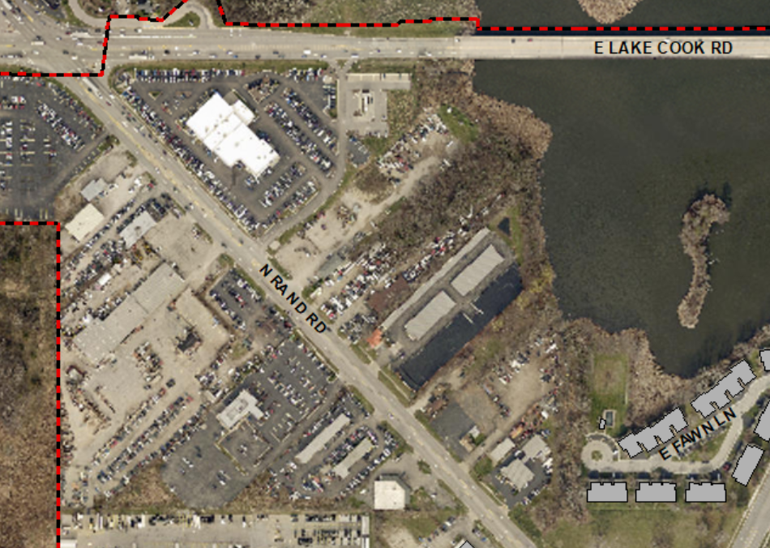
Development Update
Far North Area

Slide 15
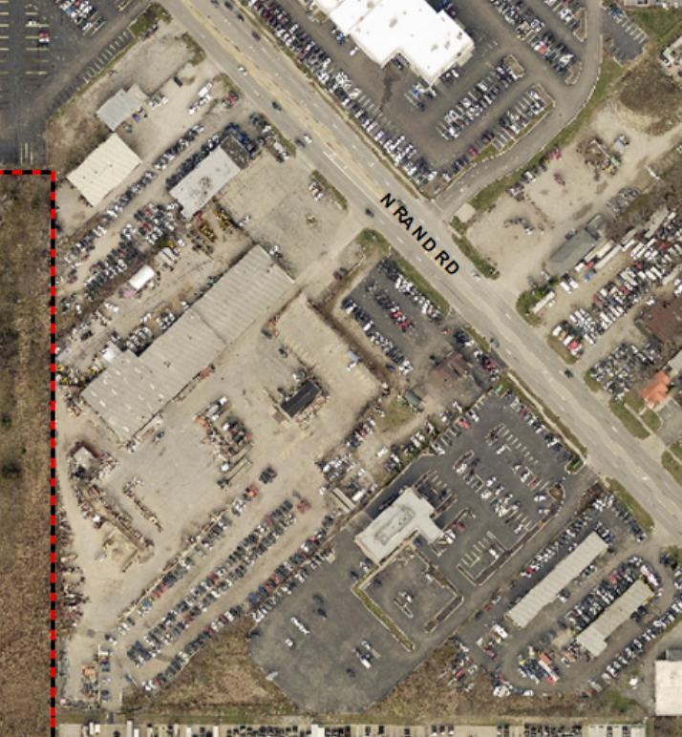
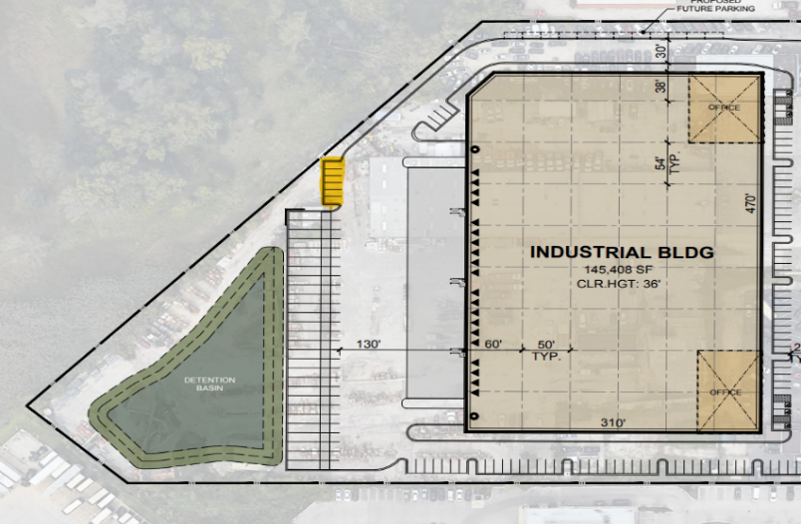
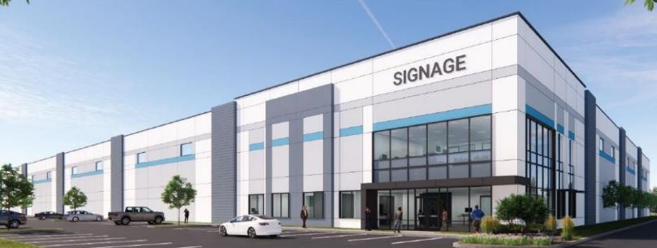
2240-2296 N. Rand Road

Slide 16
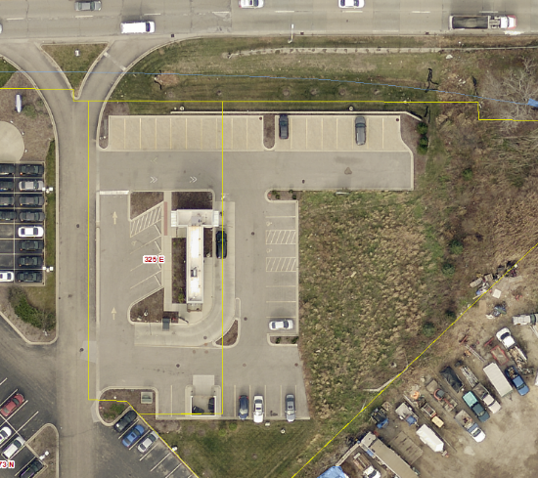
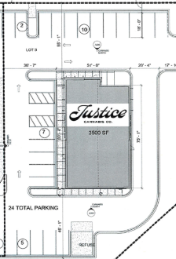


Bloc Dispensary
Lake Cook Road

Slide 17
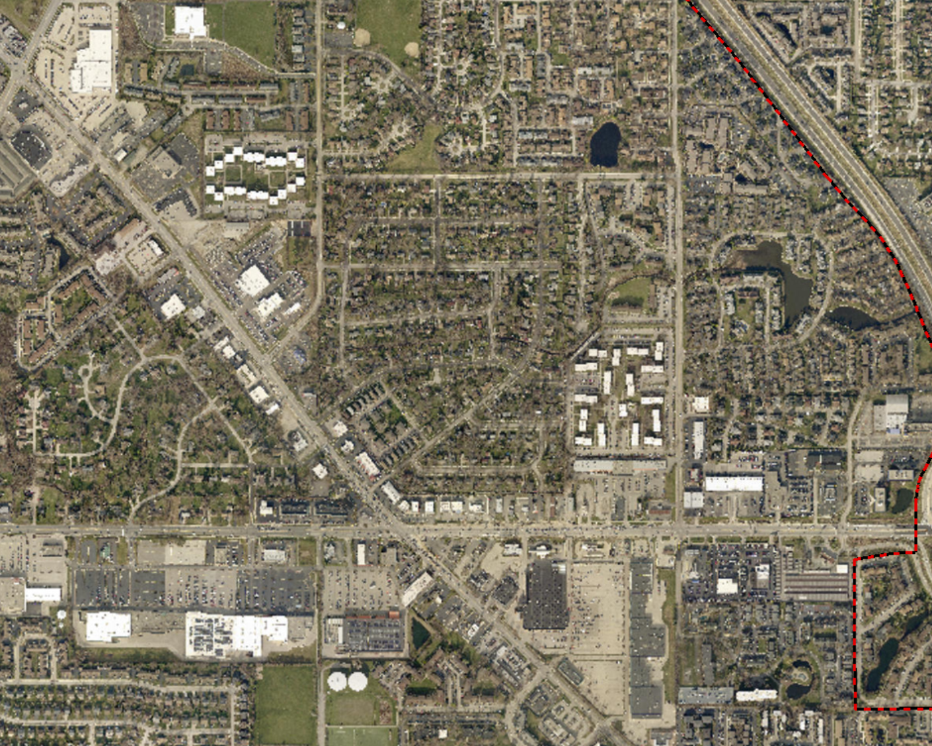
Development Update
North Area

Slide 18
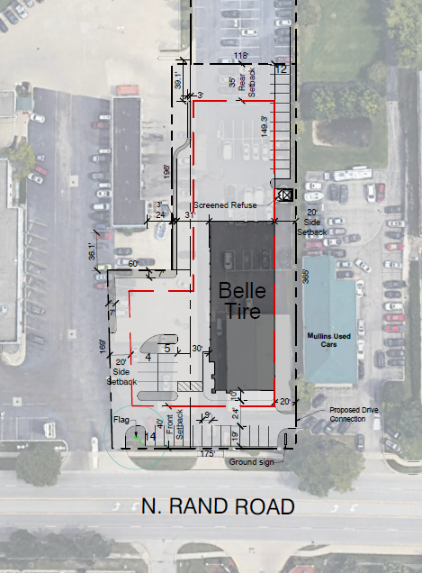
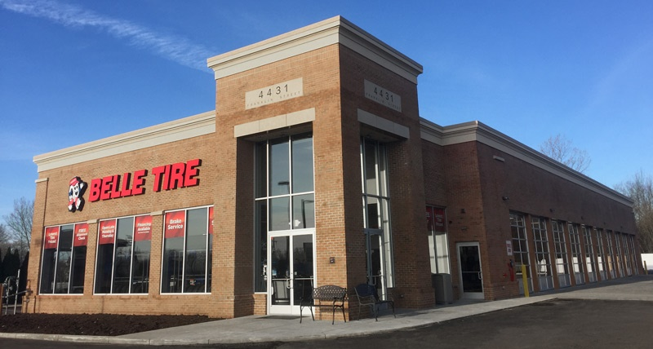
Belle Tire

Slide 19
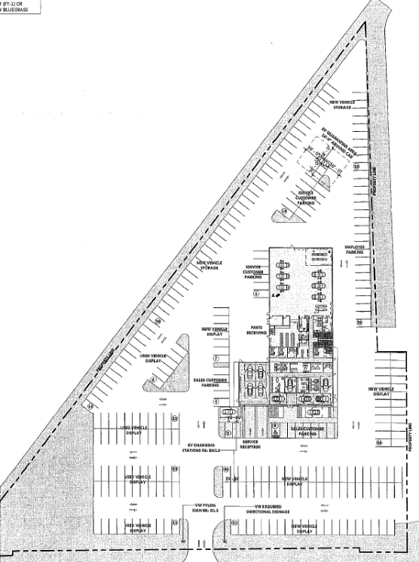
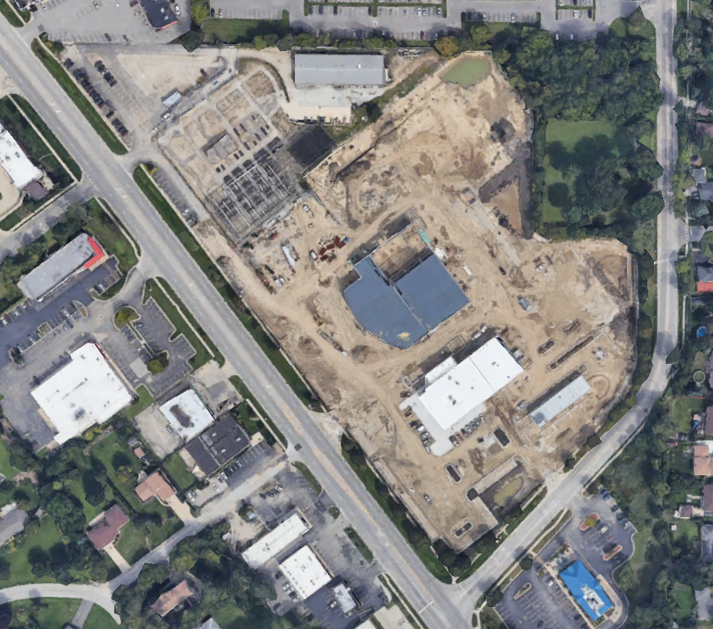

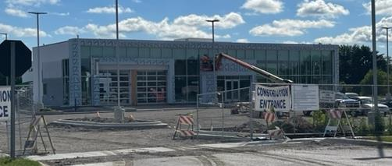

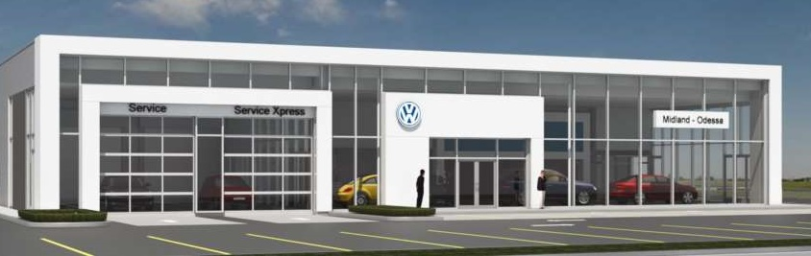

Volkswagen
N. Rand Rd.
N. Old Hicks Rd.

Slide 20
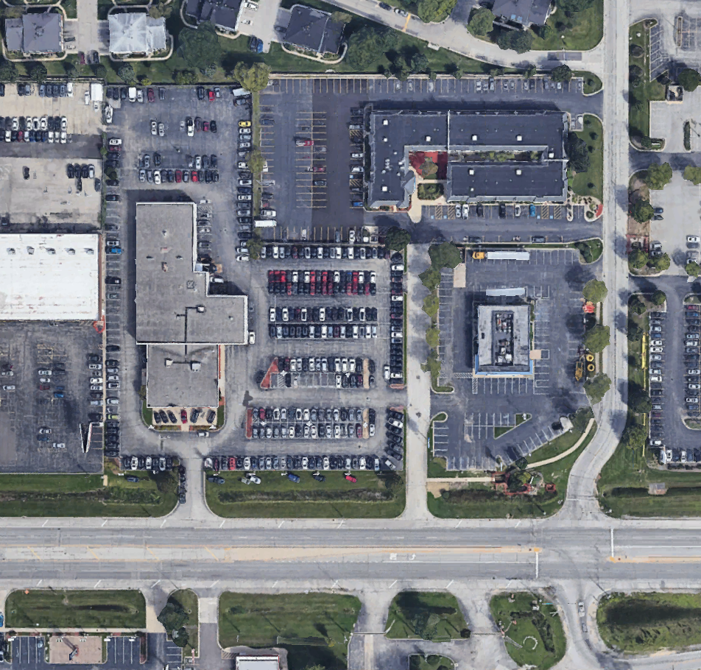
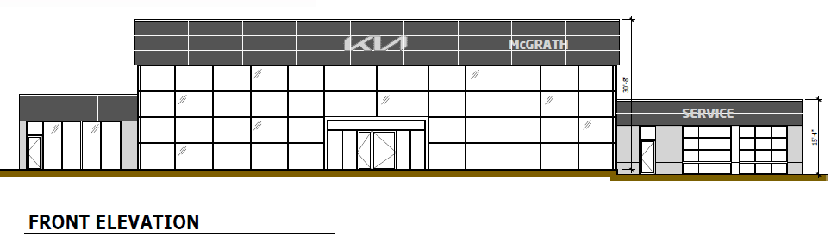
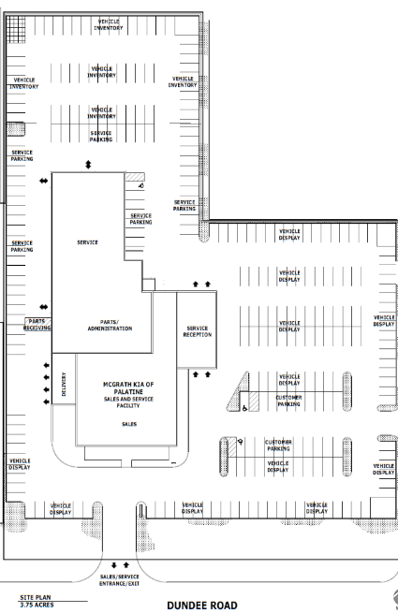
McGrath Kia
Dundee Rd.

Slide 21
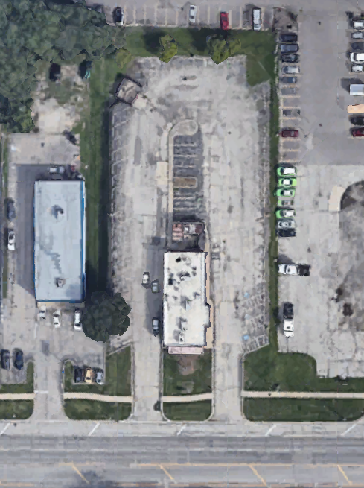
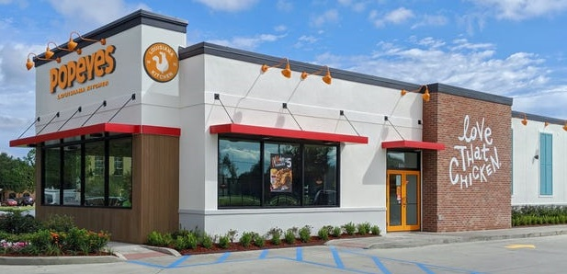
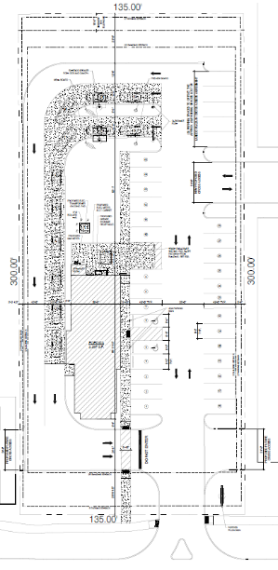
Popeye’s Chicken
Dundee Road

Slide 22
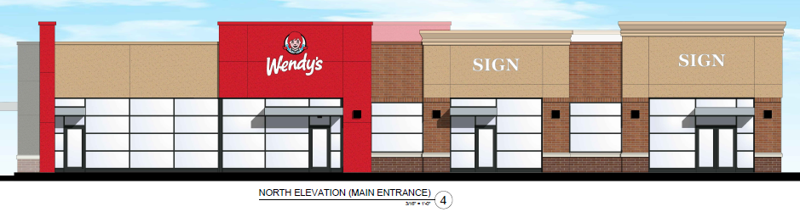
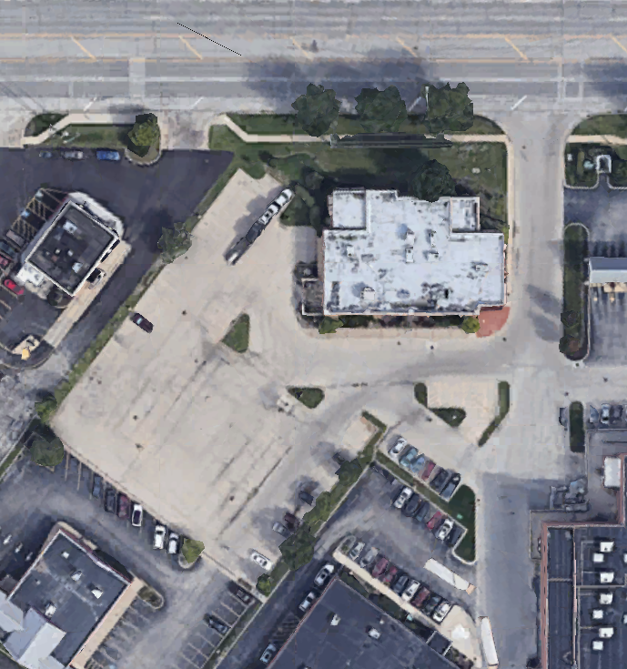
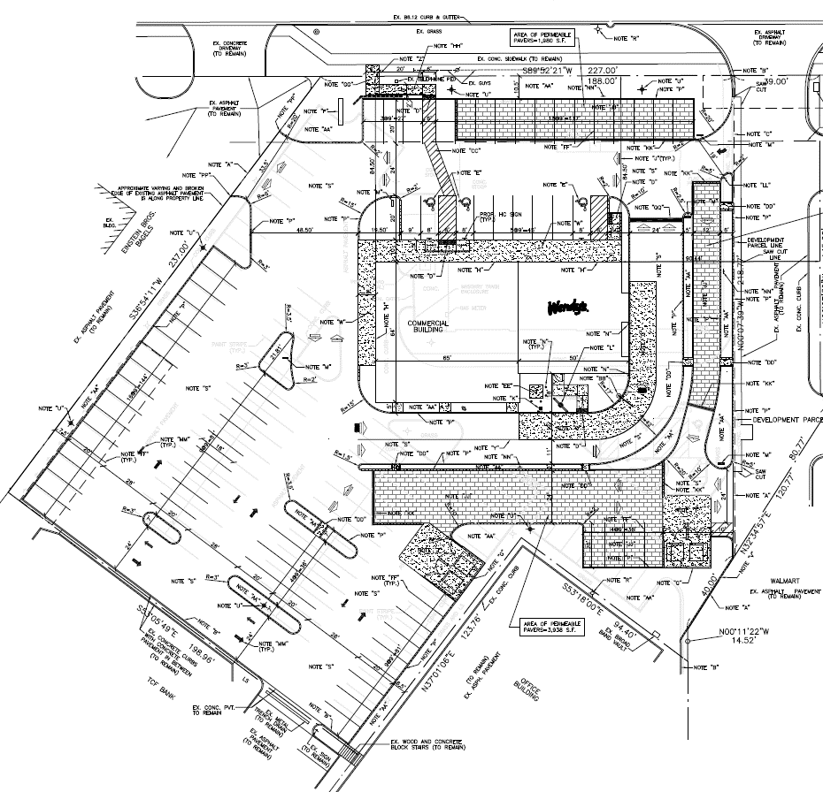
Wendy’s

Slide 23
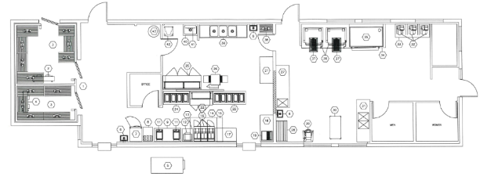
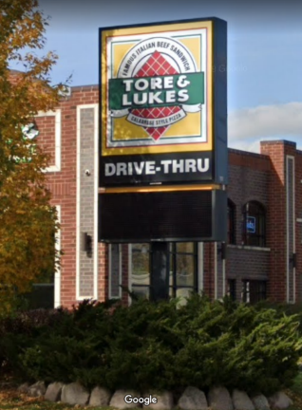
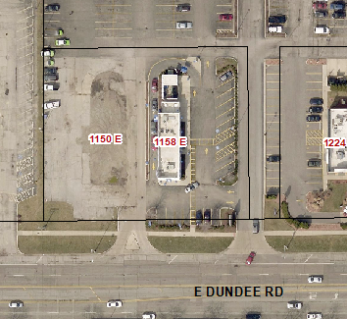
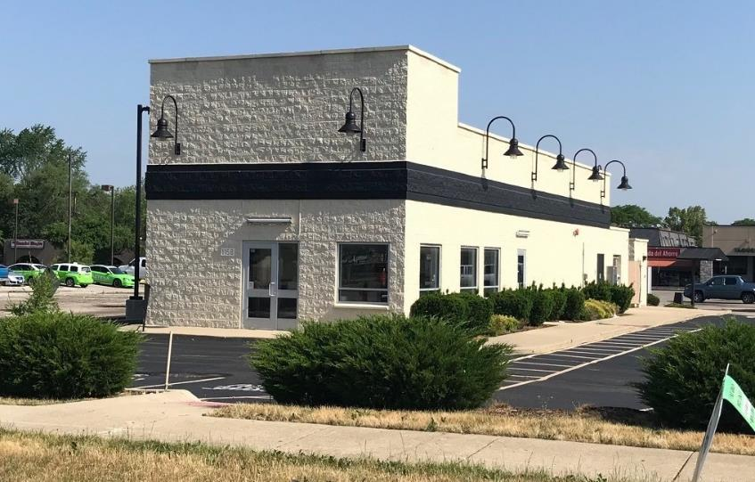
Tore & Luke’s

Slide 24
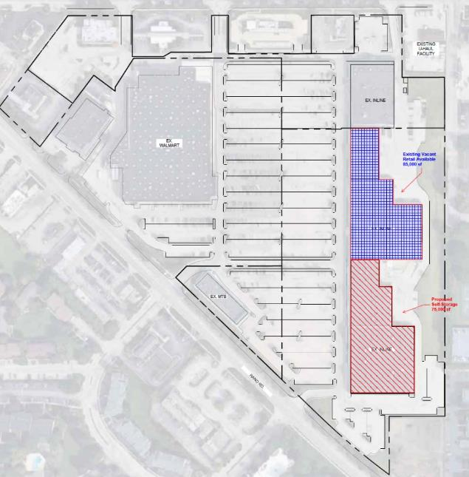
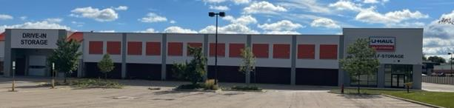
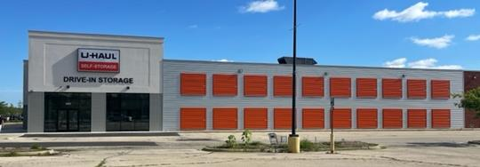
U-Haul Self Storage

Slide 25
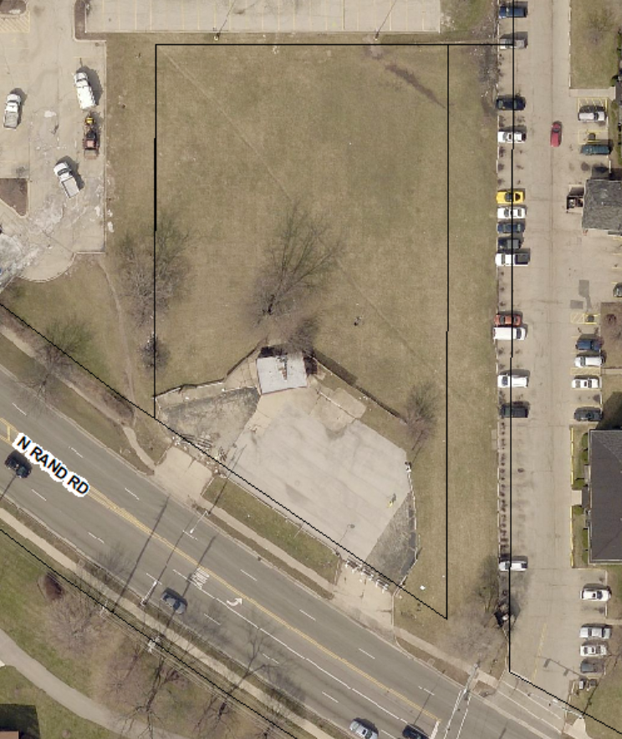
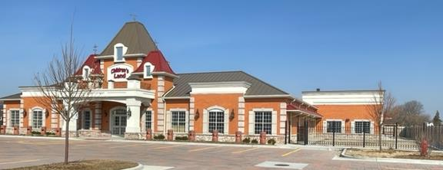
Children’s Land

Slide 26
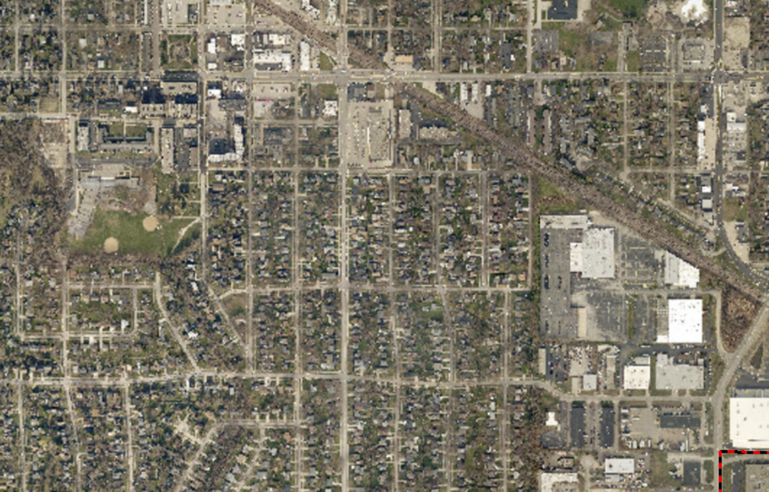
Development Update
Central Area

Slide 27
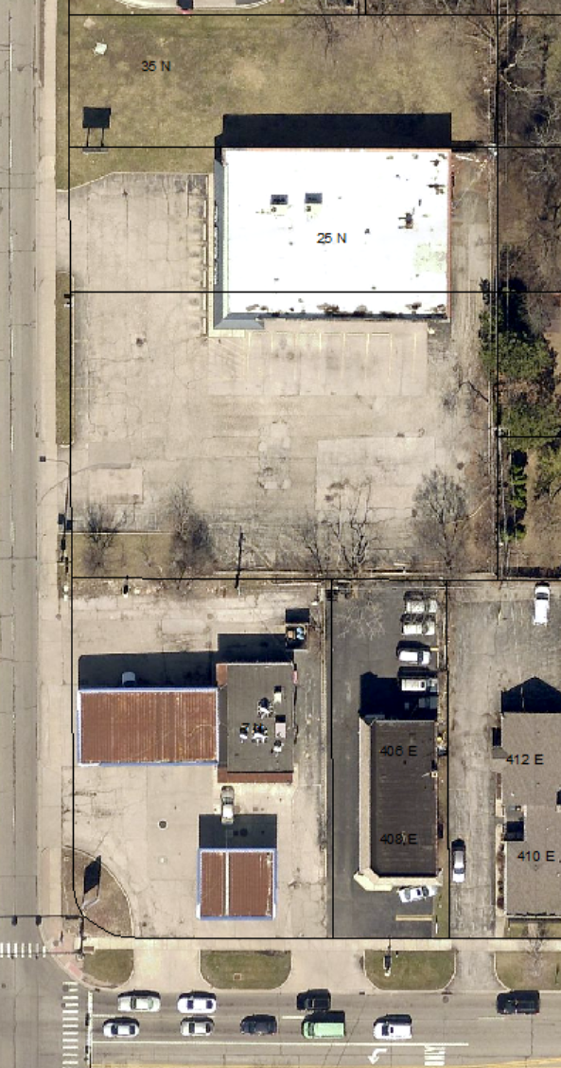
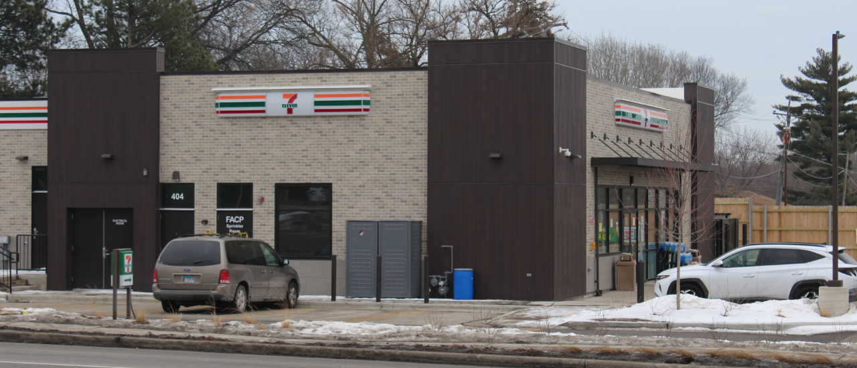
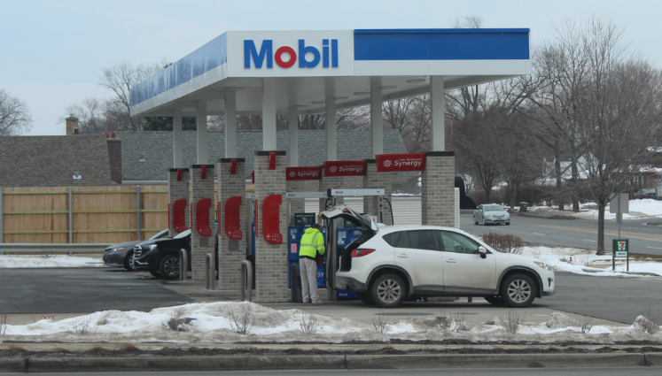
7-Eleven
N. Hicks Rd.
E. Palatine Road

Slide 28
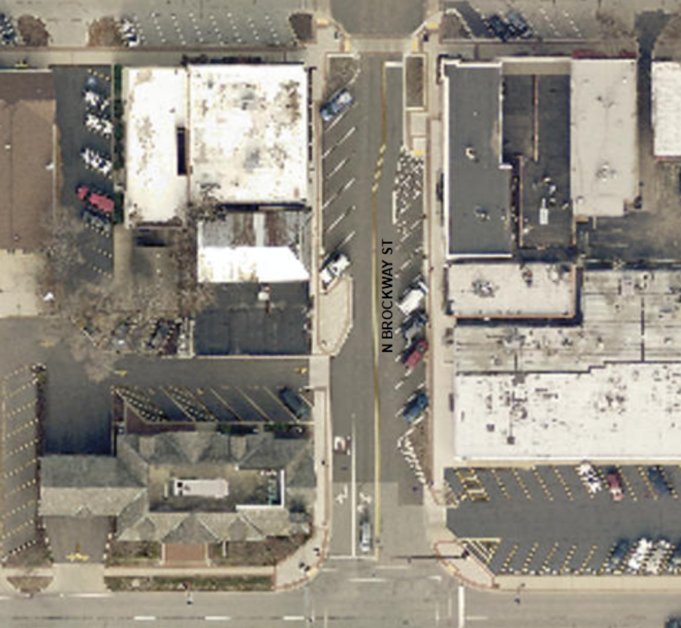
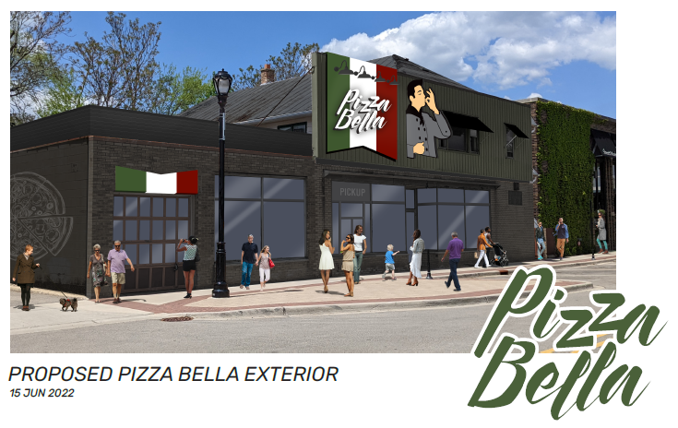
Pizza Bella – 16 N. Brockway Street
W. Palatine Road

Slide 29
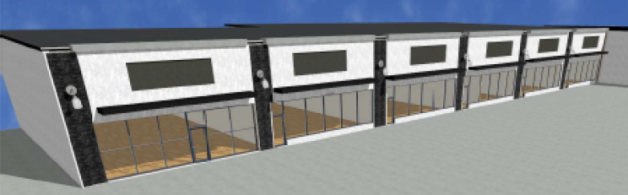
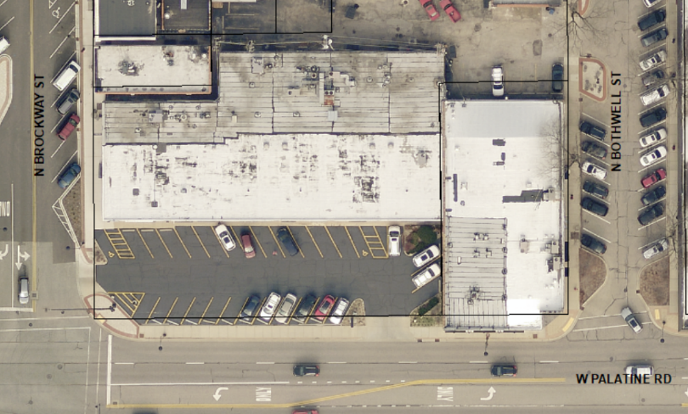
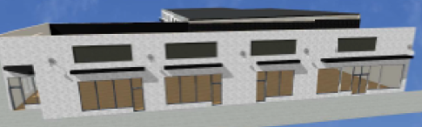
32 – 60 W. Palatine Road

Slide 30
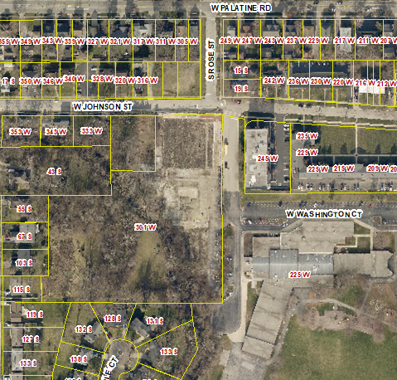
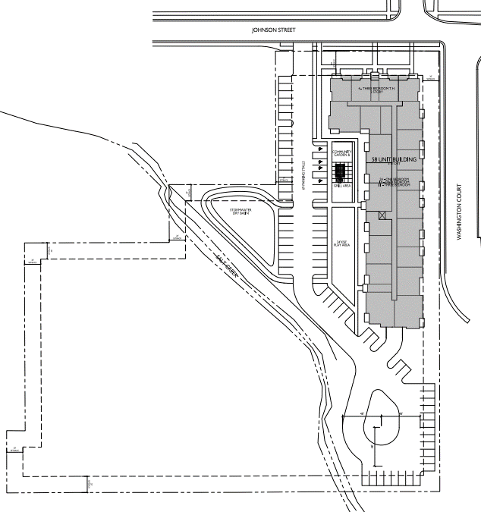


Former Kinsch Nursery Property

Slide 31


Palatine Corporate Center

Slide 32

Development Update
South Area

Slide 33



The Pride

Slide 34

St. Michael’s Annexation
300 acres
(2020)

Slide 35



Algonquin Road
Site
28 acres

Slide 36
Warehouse Financial Impact
 | Amazon | Weber | St. Michaels
Previous Property Tax | $117,000 | $590,000 | $0
Projected Property Tax | $1.4 million | $2.3 million | $2.7 million
Village Share of Tax | $154,000 | $253,000 | $297,000
Upon Completion and Full Assessment
Total Property Tax Generation of $6.4 million to Community

Slide 37
Quentin Road Update
Continued Lack of Progress
Village Regularly Pushes for Updates from County
August 10th Meeting with County Commissioner and County Staff
What studies need completing
When will they be completed
When is next public input meeting
When will staff make recommendation and when will County Board consider
Status of resurfacing Quentin

Slide 38

Quentin Road Update

Slide 39

Quentin Road Update

Slide 40







Palatine E-News
Other
Matters
Communication
Liquor License Changes
Bears Relocation
Questions???
???

