Slide 1

District One and Two
Residents’ Meeting
October 9, 2024
Tim Millar
District One Councilman
Scott Lamerand
District Two Councilman

Slide 2
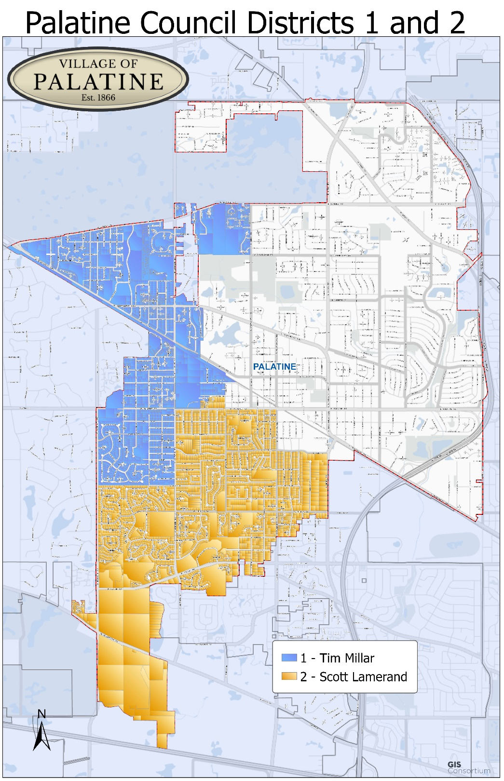
Welcome
Jim Schwantz
Mayor
Reid Ottesen
Village Manager
Hadley Skeffington-Vos
Deputy Village Manager
Bill Nord
Police Chief
Matt Barry
Public Works Director
Chris Stearns
Police Commander
Corrina Magnus
Police Sergeant
(8100 Beat in 2025)

Slide 3

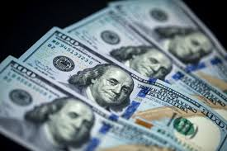
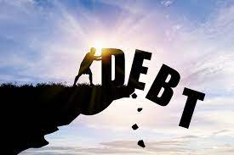
Financial Position

Slide 4
2025 Annual Budget Preview
No property tax increase (6th consecutive year)
Significant Infrastructure Investment:
$5 million for Harper water tower
Downtown Reinvestment
Funding to Complete Facility Improvements
Police Department Restructuring
No levy for debt service (“Debt Free” Status)

Slide 5
Outstanding Debt Obligation
2011 to Present

Slide 6
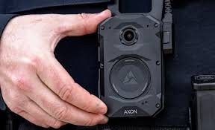
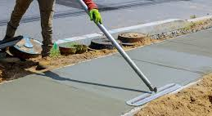
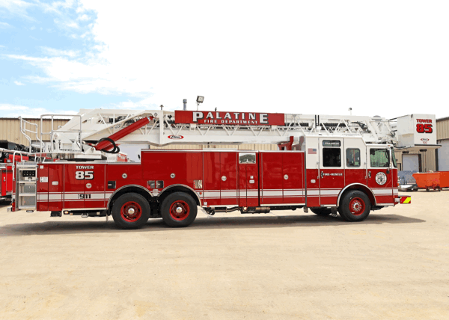
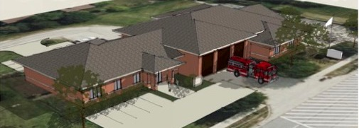
American Rescue Plan Act (ARPA) Funding
PROJECT | ALLOCATION
Police Body Cameras | $3.5 million
Fire Station 82 Addition | $3.25 million
Fire Tower Truck | $1.35 million
Fire Ambulance | $385,000
Public Safety Field Laptops | $255,000
Outdoor Warning Sirens | $240,000
Chest Compression Devices | $33,500
Sidewalk Expansion/Replacement | $1.04 million
Creek Stabilization | $1 million
Watermain Extension | $1.02 million
TOTAL | $12 million

Slide 7
Grant Procurement
Illinois Avenue ($1.155 million)
Palatine/Quentin ($2.874 million)
Creek Stabilization ($350k)
Baldwin Bridge ($1.861)
Palatine and Rohlwing ($2.379 million)
Dundee and Hicks ($2.531 million)
Michigan Avenue ($550k)
Trees ($30k)
Water System (Standpipe) ($600k)
Lead Service Line ($50k)
Electric Motorccyle ($50k)
Palatine Road
$12.43 Million in Grants
=
57% Increase in Property Taxes for one year

Slide 8
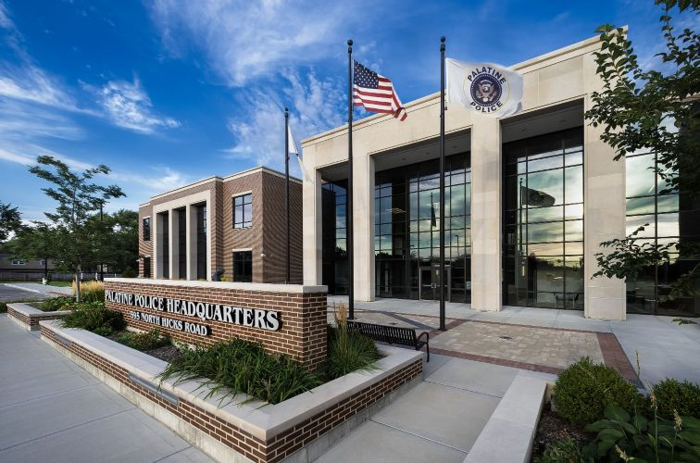
Police Initiatives and Updates
Community Engagement and Planning Division
Refocus on Neighborhood Based Policing
Social Services
Emergency Management
Grant Procurement and Planning
Beat Issues

Slide 9




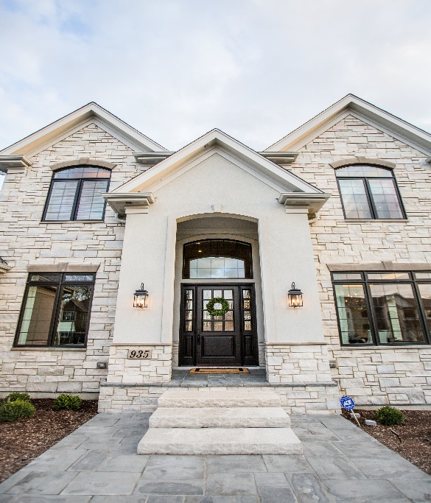



Development Updates

Slide 10
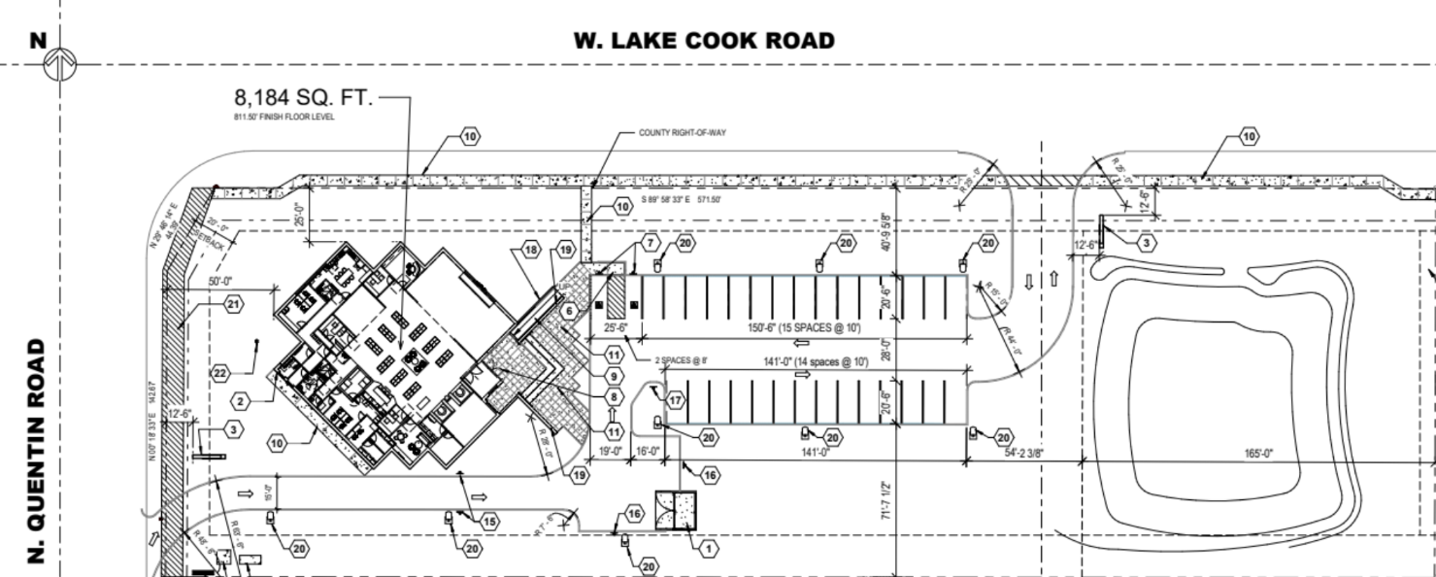


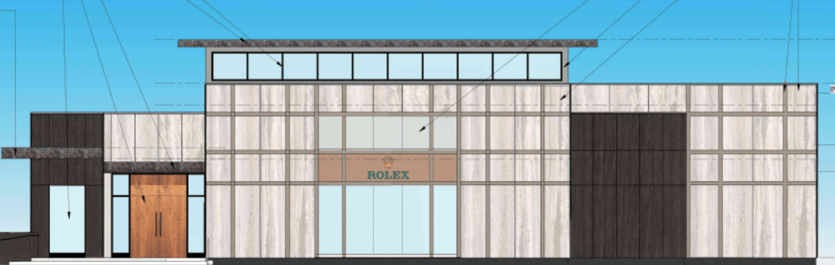
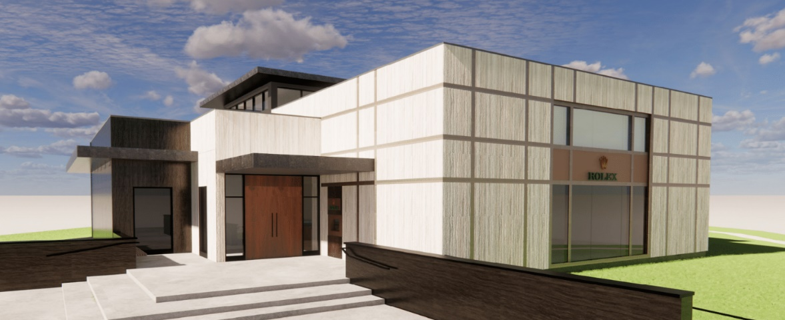
Persin & Robbin (Quentin & Lake Cook Roads)
Sales Tax Sharing
Extension of Sanitary
Property Tax Payments
Notes:
Foundation is in.
Opening anticipated in Summer, 2025
Village to get 50% of all sales taxes
Payment equal to what the municipal property tax would have been in Palatine

Slide 11
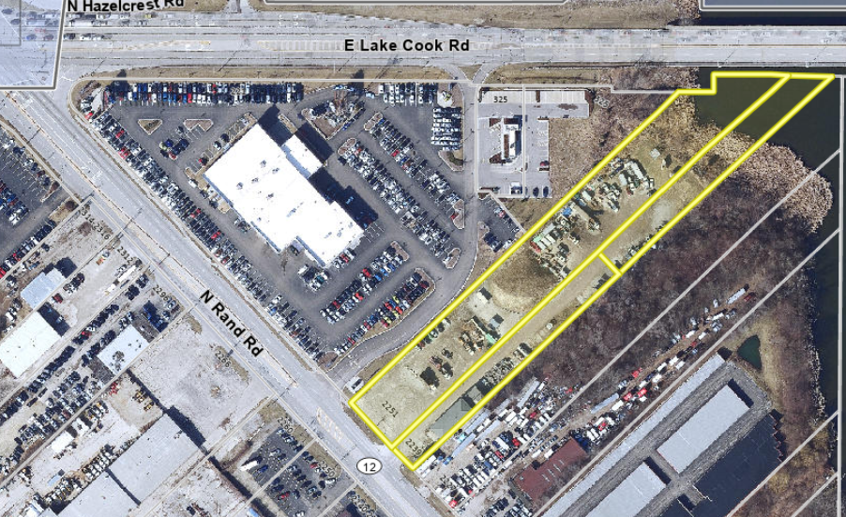
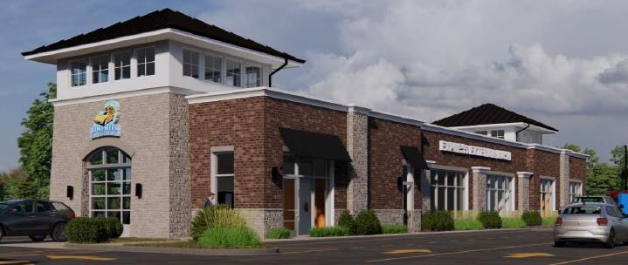
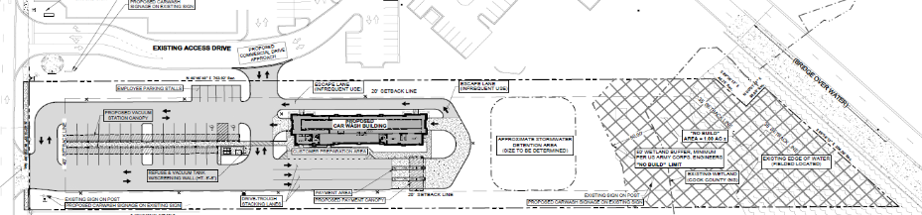
Car Wash 2239 – 2251 N. Rand Road

Slide 12
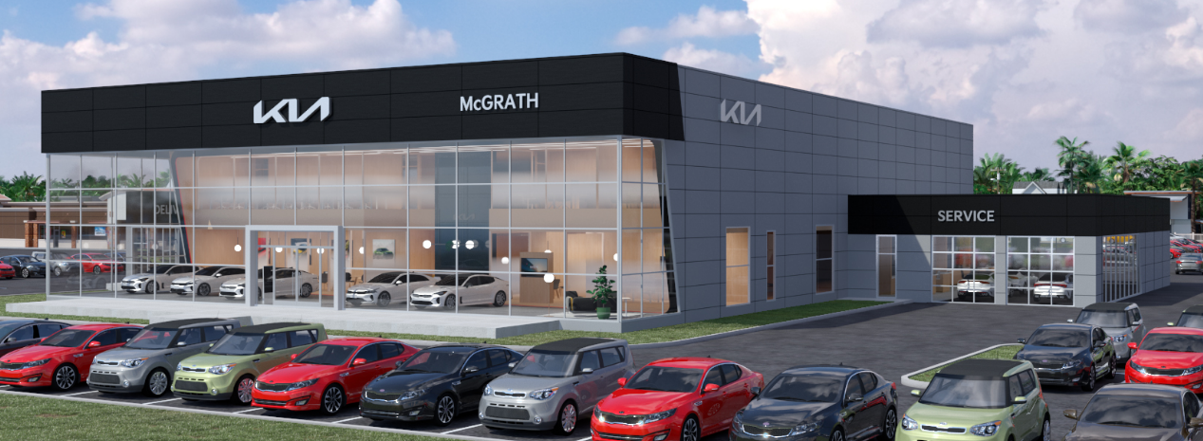
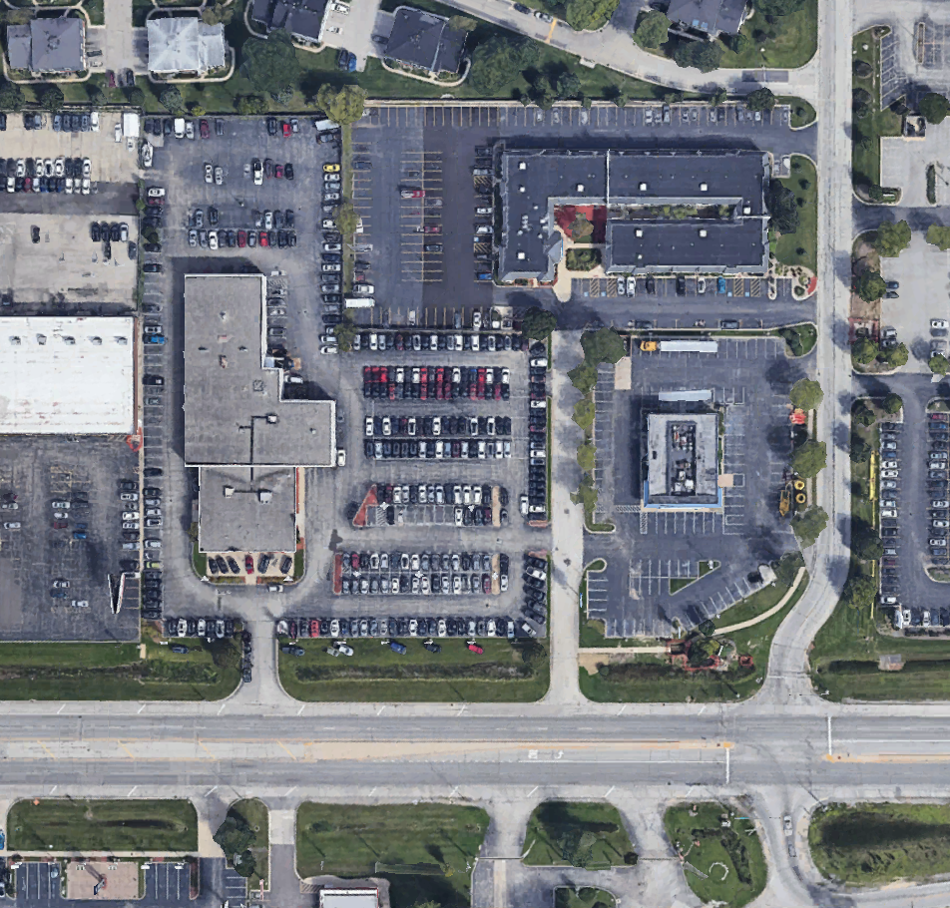
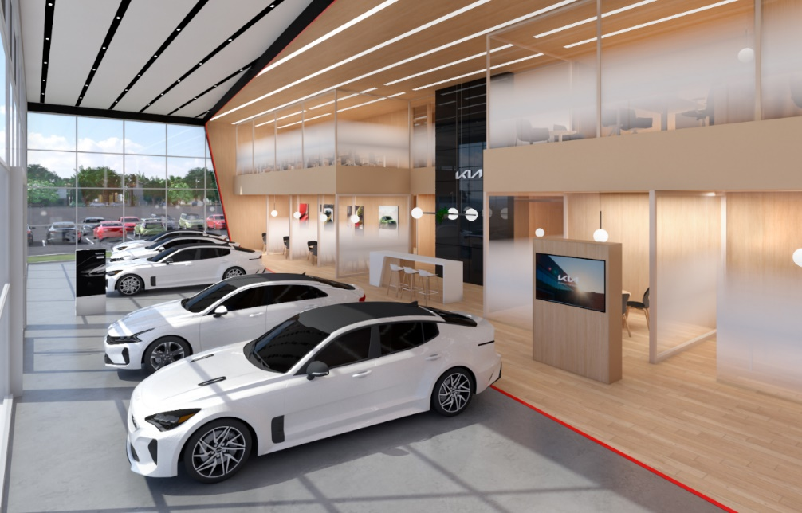
McGrath Kia
Dundee

Slide 13
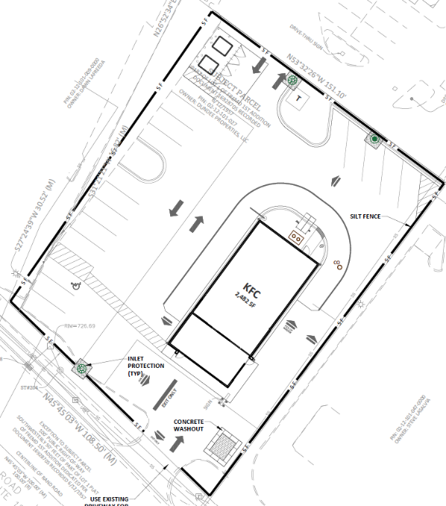
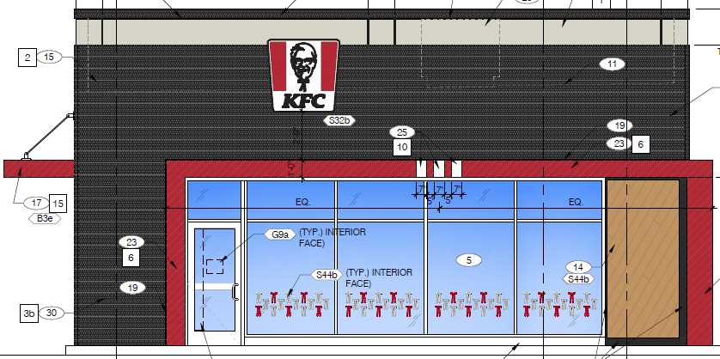
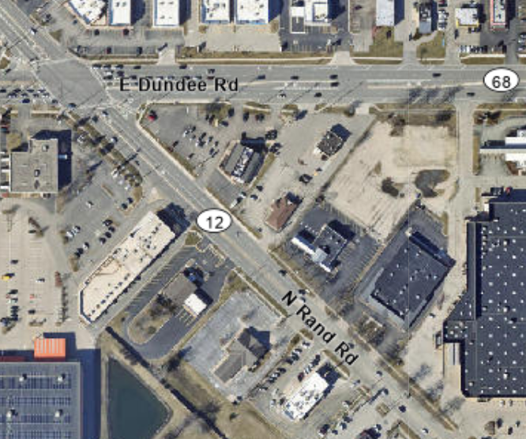
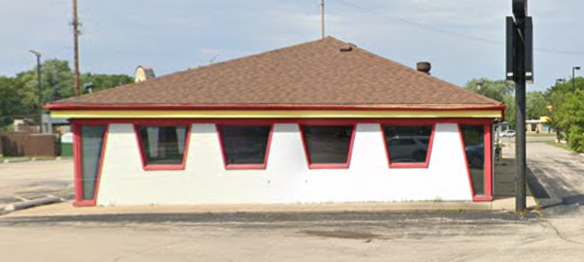
KFC 1597 N. Rand Road
Proposed Elevation
Existing Building

Slide 14
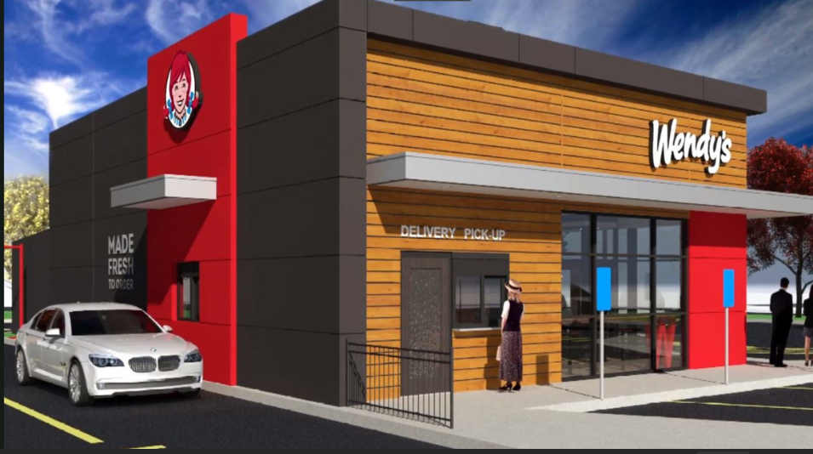
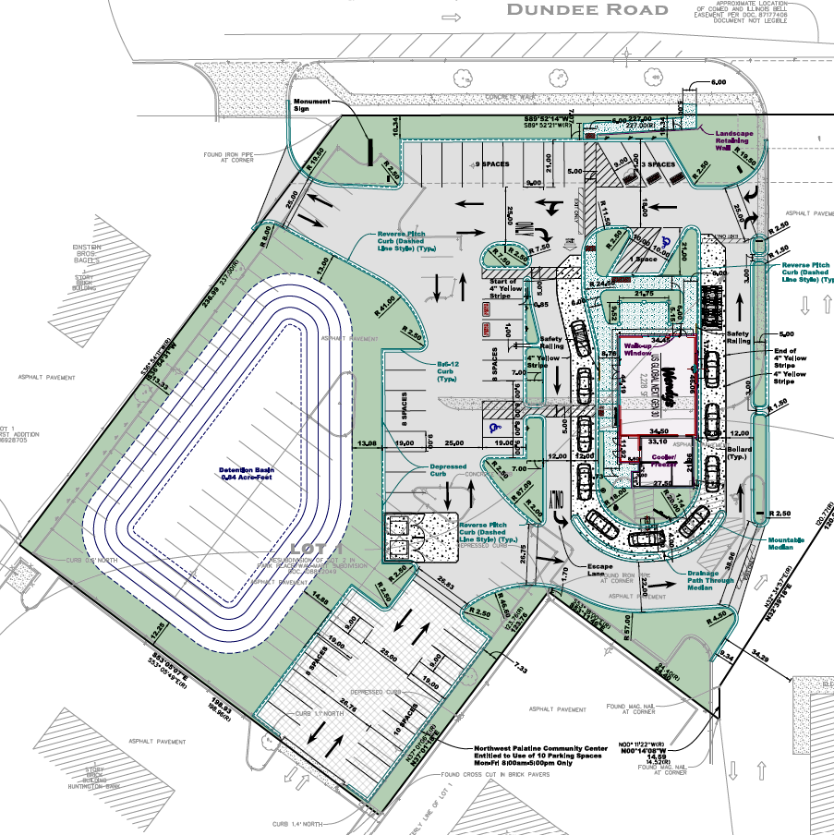
Wendy’s 1101 E. Dundee Road

Slide 15
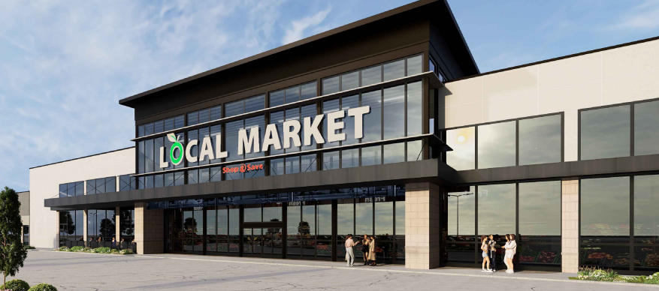
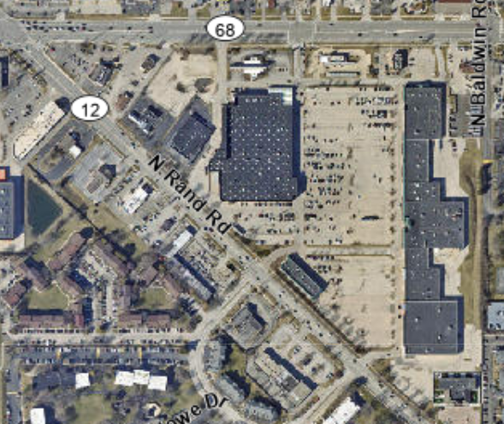
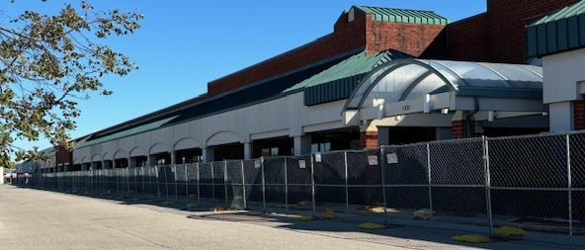
Local Market – Shop & Save 1331 N. Rand Road

Slide 16
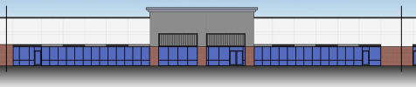

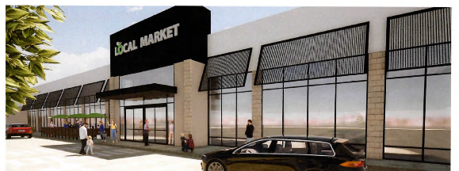
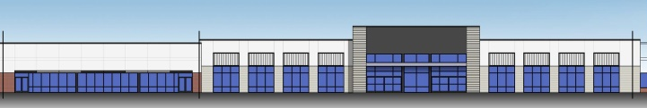
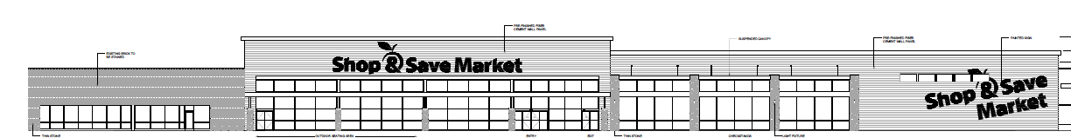
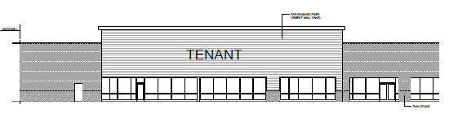


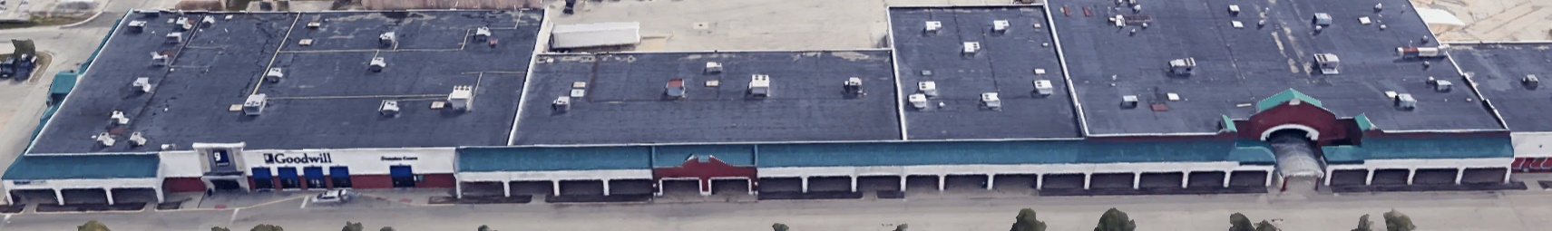
Park Place Center – Façade Improvements and Grocer
Preliminary Façade Plan

Slide 17
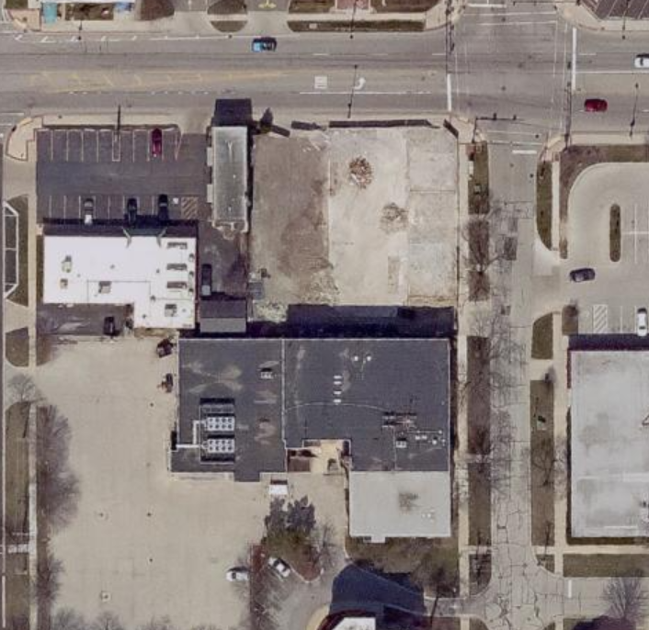
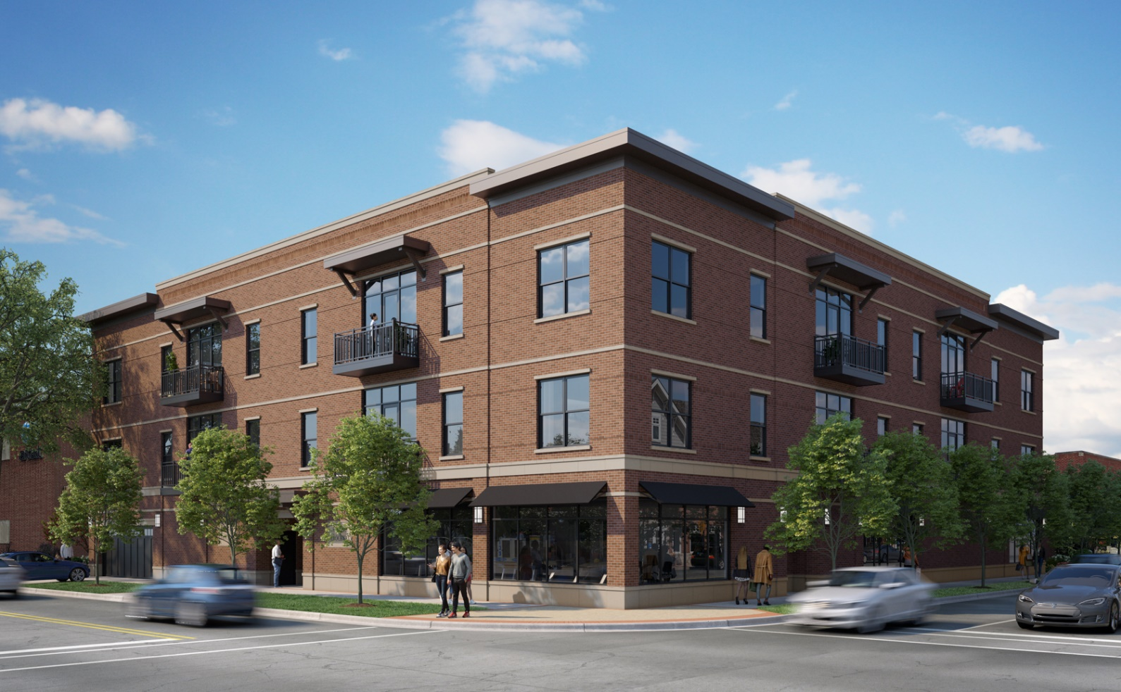
101 W. Palatine Road (former Kramer Photography)
Palatine Road
Brockway Street

Slide 18
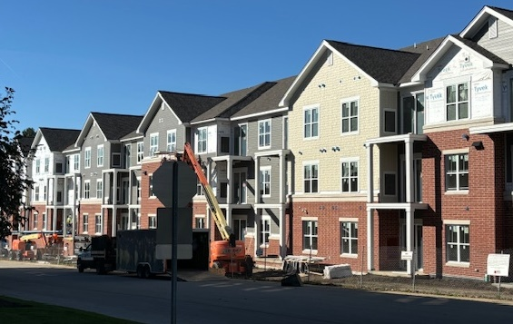
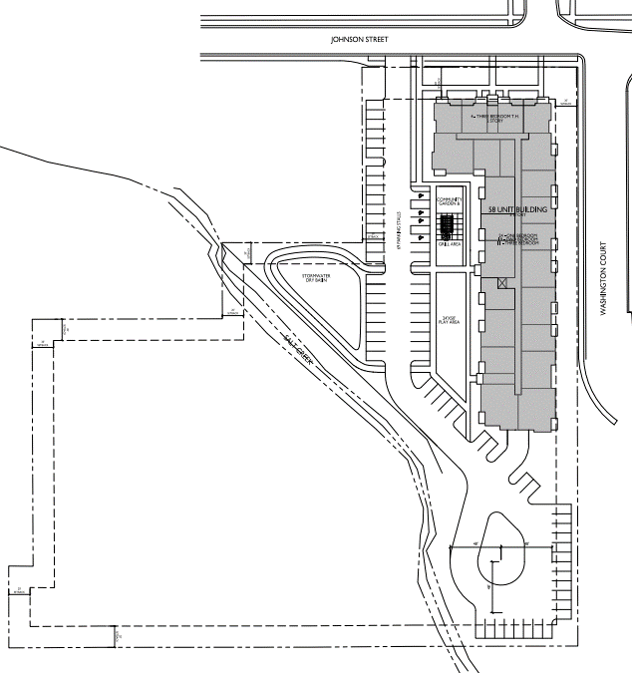
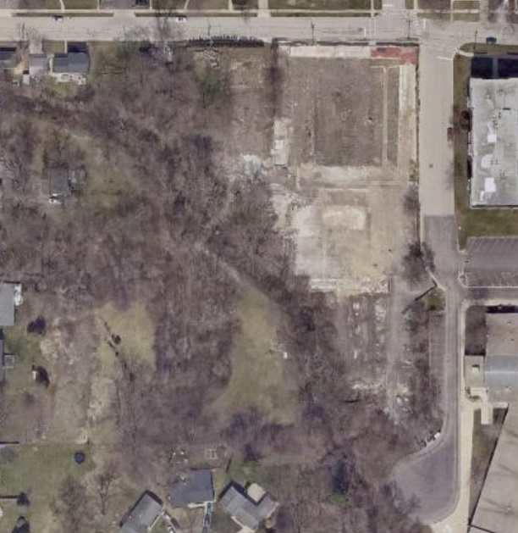
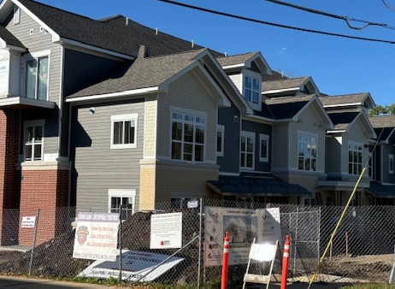
303 W. Johnson Street (former Kinsch Nursery)
Johnson Street
Townhomes: 4 Units
Apartments: 54 Units

Slide 19
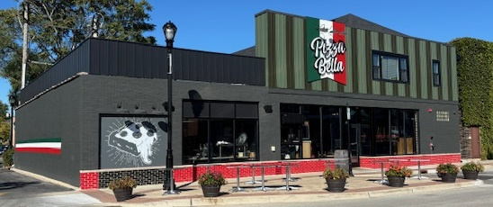
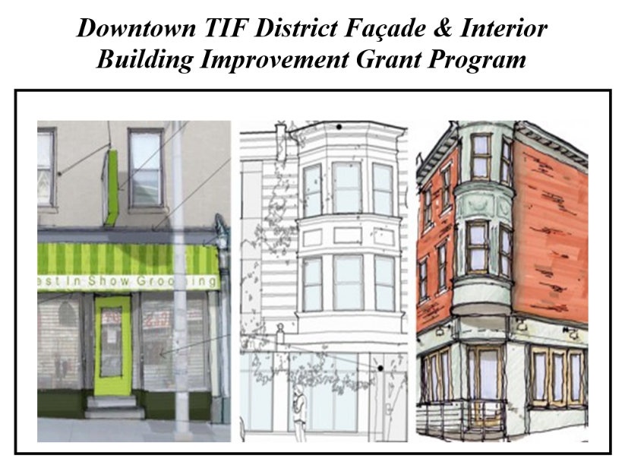
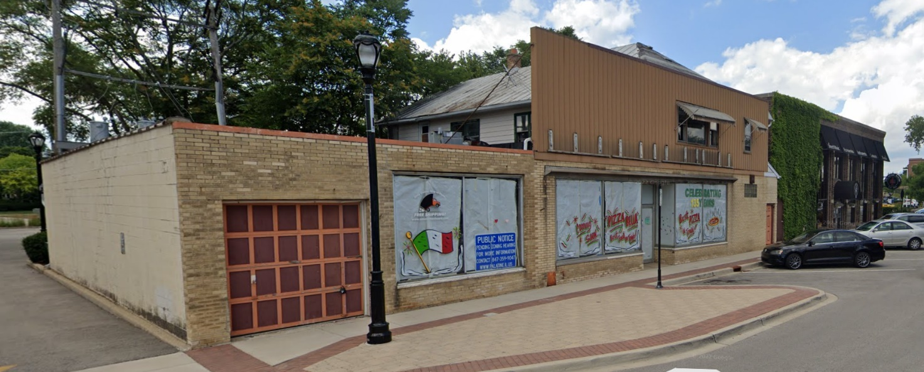
Pizza Bella – 16 N. Brockway Street
After
Before

Slide 20
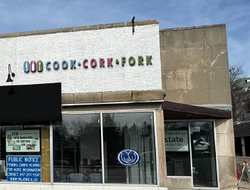
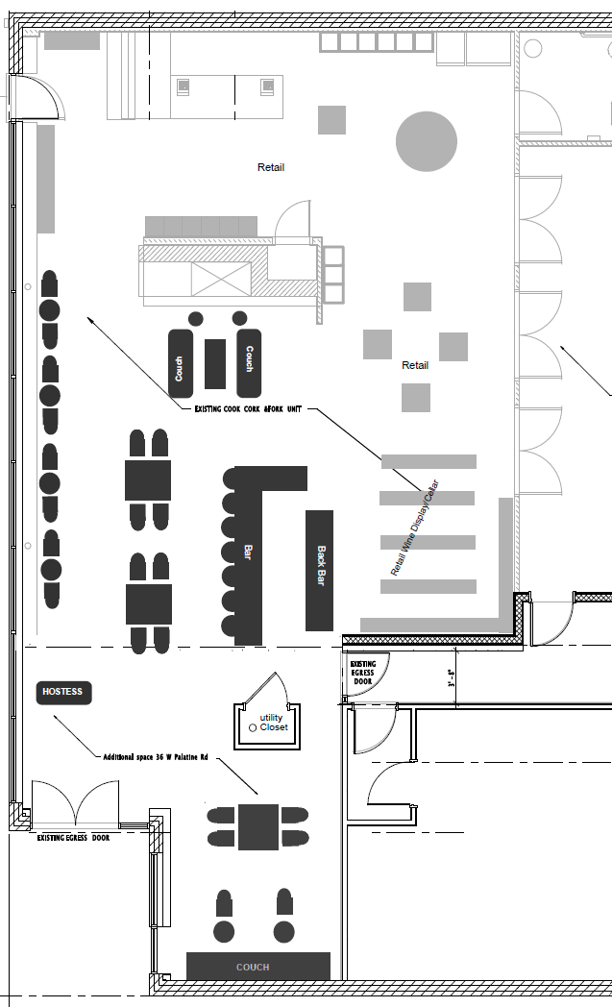
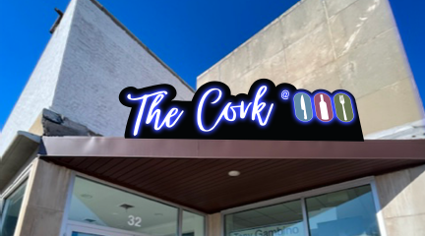
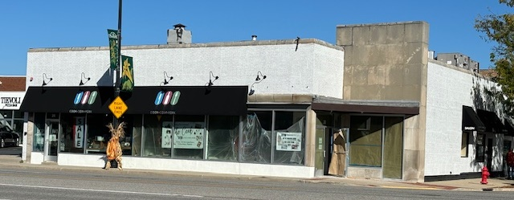
Cook Cork & Fork and The Cork

Slide 21
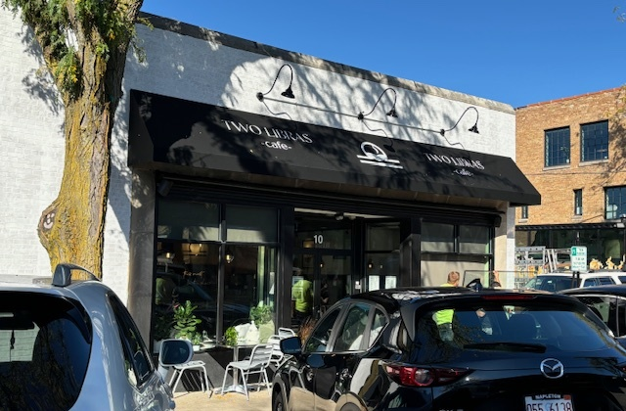
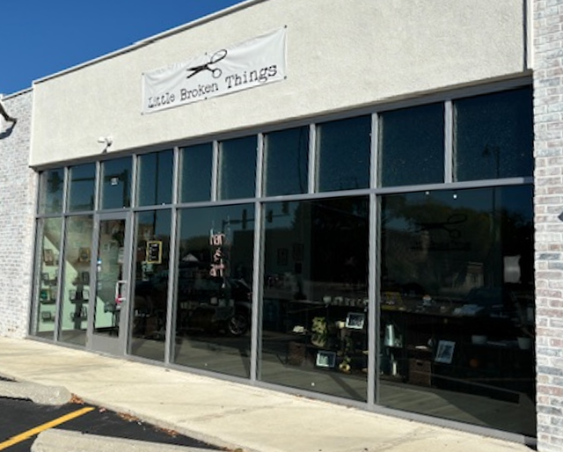
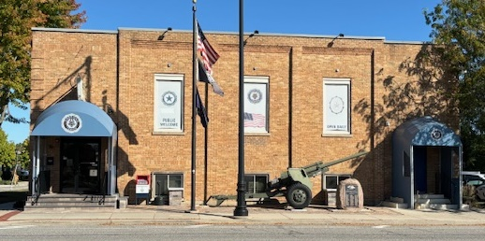
Two Libras Cafe
10 N. Bothwell Street
Little Broken Things Salon
48 W. Palatine Road
American Legion
122 W. Palatine Road

Slide 22
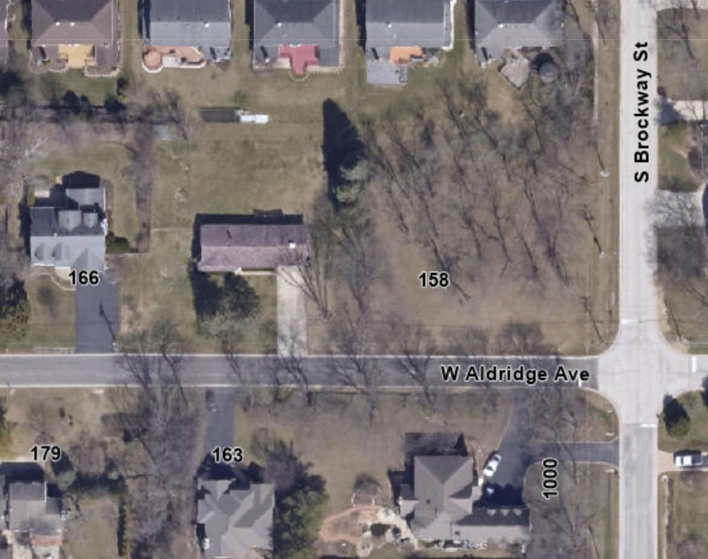


Nessie’s Grove Resubdivision

Slide 23




Estates at Arcadia Subdivision (proposed 6 lots)

Slide 24




Algonquin Road – 370,000 sq. ft.
Algonquin Rd.
28 Acre Site

Slide 25



Other Topics of Interest
Comprehensive Land Use Plan Update
Quentin Road
Chicago Bears
Downtown
“Green” Initiatives
Palatine Road

Slide 26



Downtown
BMO Public Parking
Palatine and Plum Grove Improvement
Streetscape and Outdoor Dining
Palatine Road

Slide 27
Green Initiatives
4 Electric and 34 Hybrid Vehicles
Charging Station grant
LED Lighting – Buildings and Streets
LEEDS level construction
Rain Gardens and other landscape enhancements
Textile Recycling
Community Solar program
Expansion/Investment Bike Routes
Tree City USA
Bronze level SolSmart community
SWANCC partnership recycling and shredding events
Palatine Road
Notes:
Promotion of environmentally sustainable practices through Village newsletter and weekly e-newsletter
Entire marked police squad fleet (24 vehicles) are all hybrid
Approximately 10 other Village fleet vehicles hybrid
Electric motorcycle in Police
Electric van in Public Works
Electric charging being installed at PD and PW for fleet purposes
Pursuing grants for public charging stations
$500,000 appropriated in August to begin Village-wide conversion to LED street lights
All Village buildings have been converted to LED
Largest ever investment in sidewalks to promote healthy lifestyles
Ongoing expansion of the bike route program throughout Village to promote bicycle friendly community
Bicycle Transportation Plan
Complete Streets Policy
Textile recycling program to reduce landfill materials – continuing to promote
Community Solar program – continuing to promote
Annual tree planting program, Tree City USA and annual Arbor Day celebration
Bronze level SolSmart community https://solsmart.org/communities/village-of-palatine/
Resources to residents including a green building resources section on the Village website: https://www.palatine.il.us/605/Green-Building-Resources
Internal anti-idling policy for Village vehicles
Public Works does have practices to recycle materials as much as they reasonably can
Mulching program in Public Works, available for residents
Sprinkling restrictions during summer months
Moving newsletter to digital version vs. printing and distributing
Host of electronic recycling events with SWANCC

Slide 28

Questions?

